Slide 1
Food
Fruits and JUNK FOOD
Notes:
This presentation demonstrates the new capabilities of PowerPoint and it is best viewed in Slide Show. These slides are designed to give you great ideas for the presentations you’ll create in PowerPoint 2011!
For more sample templates, click the File menu, and then click New From Template. Under Templates, click Presentations.

Slide 2
Eating right for a healthy lifestyle.
1
2
3
Try to exercise every other day and stay hydrated.
Go to the grocery store to buy a variety o fruits and veggies.
Get plenty of sleep and breakfast when you wake up in the morning.
Stay confident for every step of the way…. And DON’T EAT JUNK FOOD!!

Slide 3
Go to the grocery store and buy fruits and veggies.
1
Tip: Try not to buy produce that is rotten

Slide 4
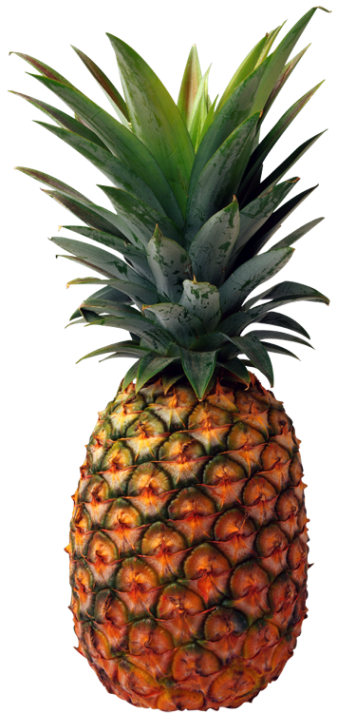
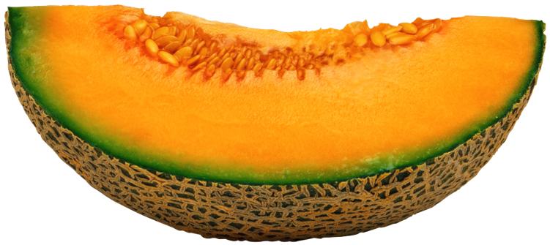
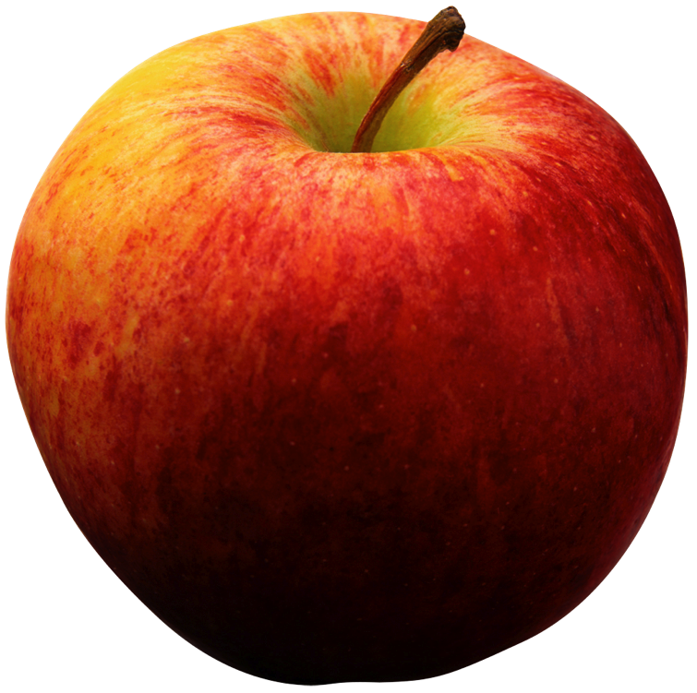
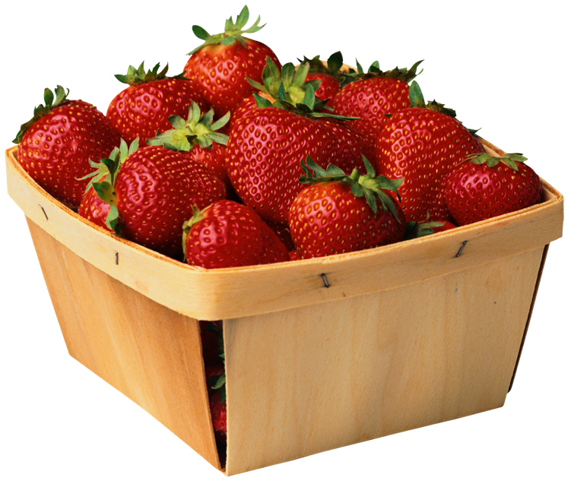
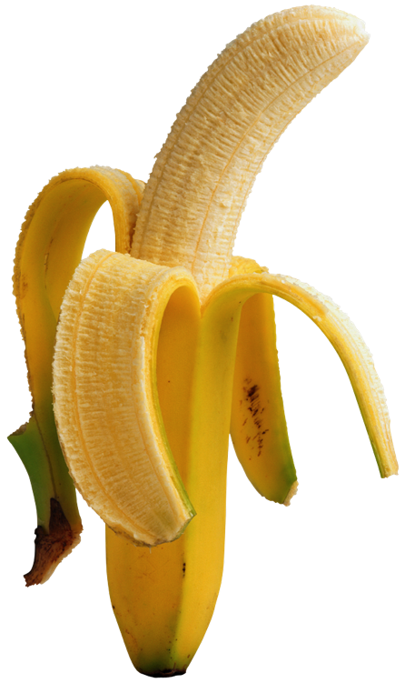
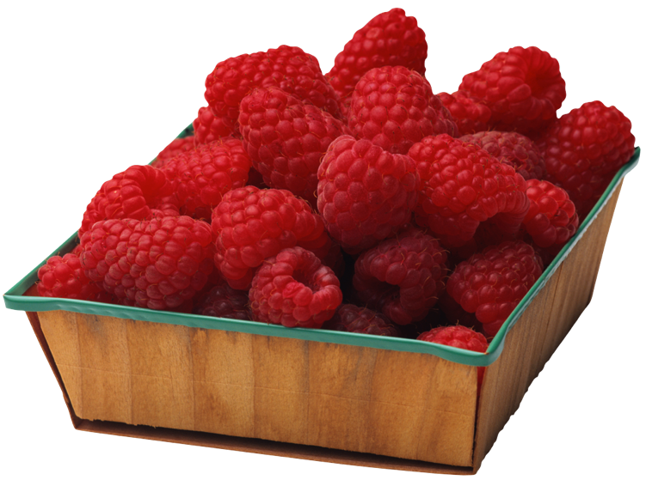
Healthy Fruits
Fruits have antioxidants and vitamins to help you stay energized and healthy. It keeps your skin glowing and can get rid of acne. Junk food has so much grease in it that when you eat all that bad cholesterol you get a greasy face which gets in your pores and clogs them up.

Slide 5
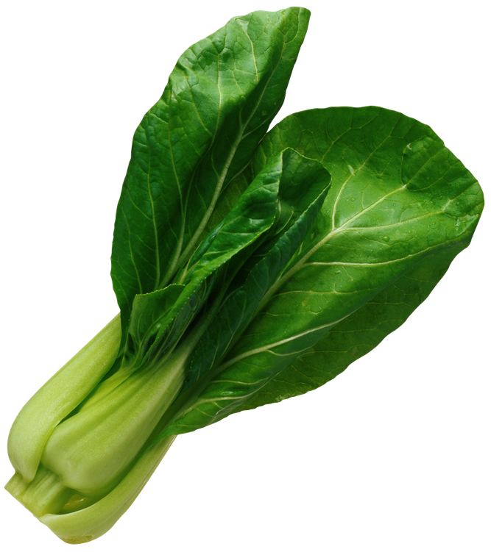
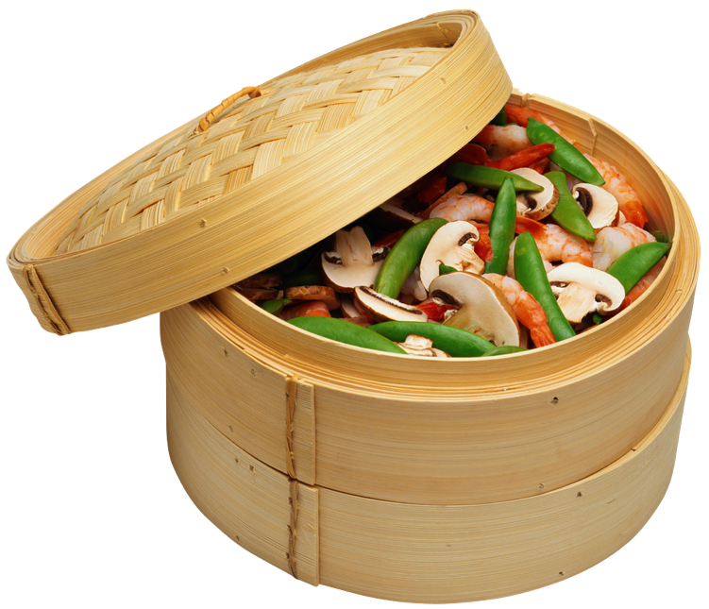
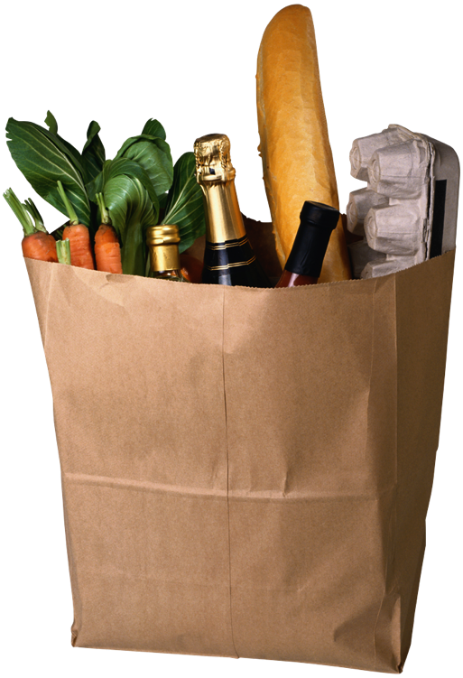
Wholesome Vegetables
There better be vegetables in your grocery bag right now! They are nourishing and beneficial to your health and taste good.

Slide 6
Try to exercise every other day and stay hydrated.
2
You can freeze a water bottle the night before and take it with you the next day.

Slide 7
WATER!!
Drink lots of fluids to prevent dehydration!!!

Slide 8
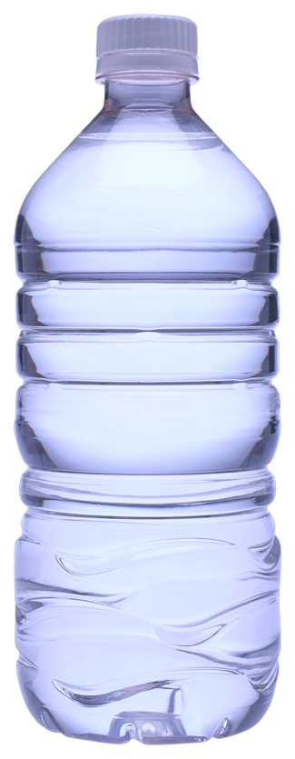
WATER!! WATER!! WATER!! WATER!! WATER!! WATER!!
When exercising drink many fluids so you don’t faint or something because that would be B A D. At the top are some examples of different fluids ,but the best choice to go with is water because it has no sugar or calories!!

Slide 9
Orange Juice
Orange juice has a lot of vitamin C that you need inside your body.
There’s different types of oranges to make the juice for example like blood orange and sweet orange.

Slide 10
It is juice made from pomegranate and has little seeds with pulp in it that tastes good, there could be from 200 to 1400 seeds!!
Pomegranate Juice
Pink and yummy.

Slide 11
Get plenty of sleep at night and eat breakfast in the morning. ☺
3
Breakfast is the most important meal of the day!!!

Slide 12
Sleep!!!
Sleep for 10 hours to stay energized the next day and you can think better also go to sleep early if you have to get up early in the morning. Coffee really perks you up!!

Slide 13
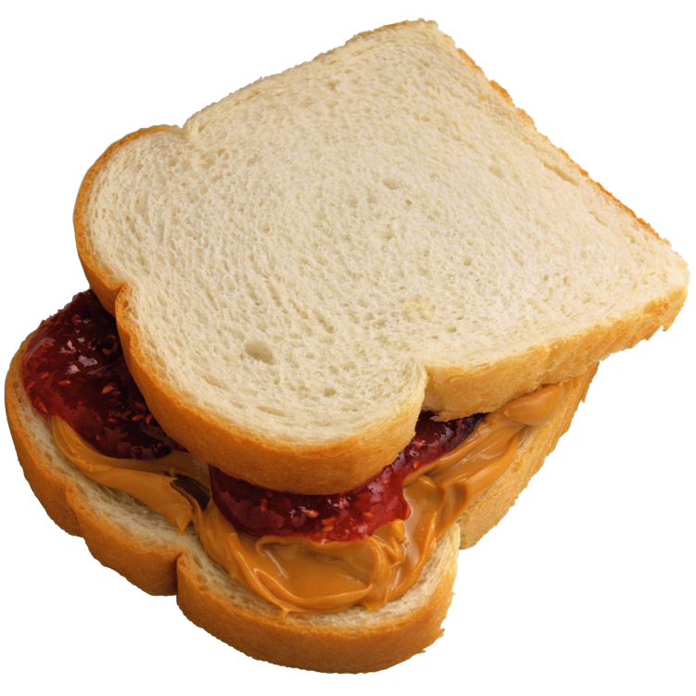
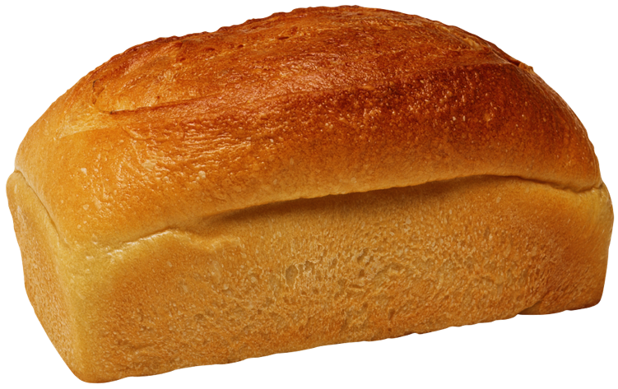
Breakfast
Breakfast is the most important meal of the day. EAT IT…..NOW well in the morning because if your taking a test that day you could get a better score if there’s energy/fuel inside you.

Slide 14
These were steps to a healthy lifestyle ☺ DON’T EAT JUNK FOOD!!
What’s Your Message?

