Slide 1
Dinosaurs
By
Victor Sedano

Slide 2
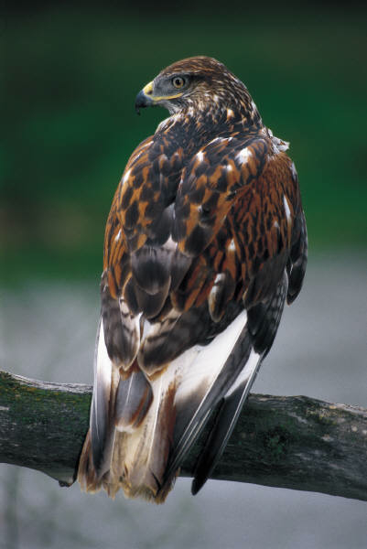
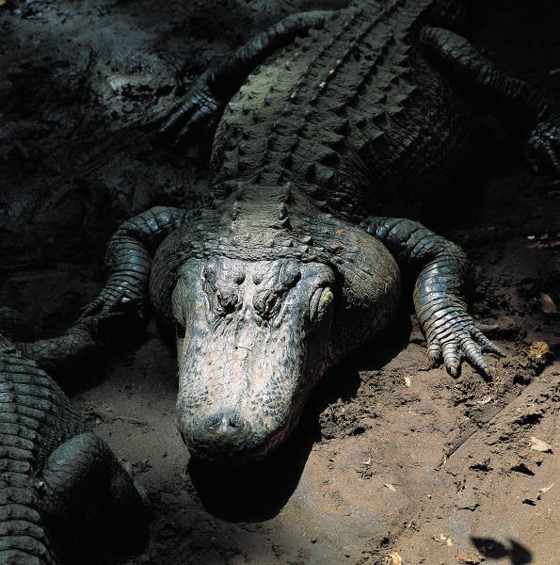
Decendents of the Dinosaurs: birds and reptiles

Slide 3
Carnivores

Slide 4
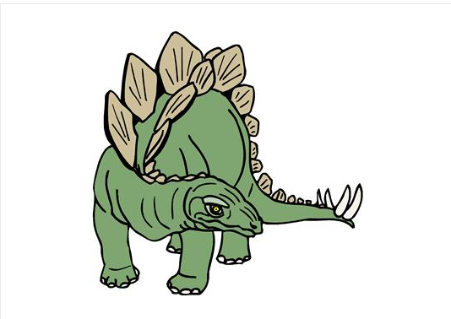
Hervivore

Slide 5
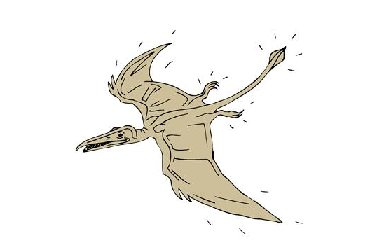
Flying Dinosaurs

Slide 6
Undersea Dinos

