Slide 1
Ships
Andy Essa
Period 3

Slide 2
Galleons
The galleon is a sailing vessel used before the Steam Age. They were used in important battles and migrations of humans. Many were used for exploration. They are used today for museums and luxury.

Slide 3

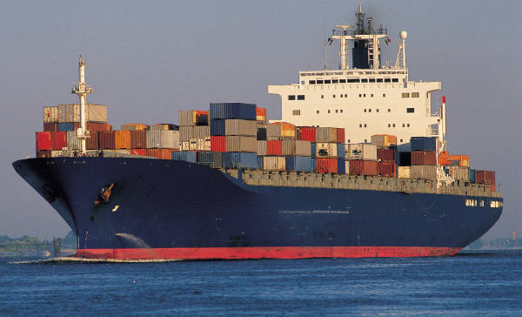

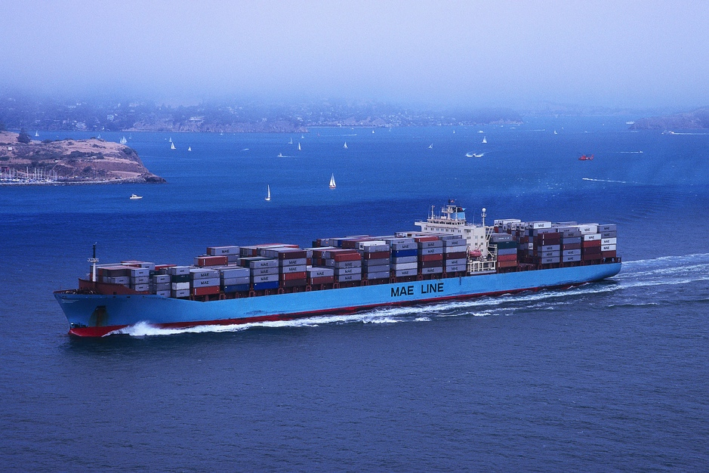
The Cargo Ship
The cargo ship is used for many things such as transporting raw materials, processed materials and even food and water. A good example is transporting oil. The food and water tankers are for disaster relief aids.

Slide 4

The Warship
A warship is a big vessel that has 3-4 giant turrets and up to 50 smaller guns. It contains radar, range directors and a crew of up to 500. It is one of the largest vessels in the fleet and were crucial in for the Pacific campaign in WW2. Also, warships are now used for giant museums.

Slide 5
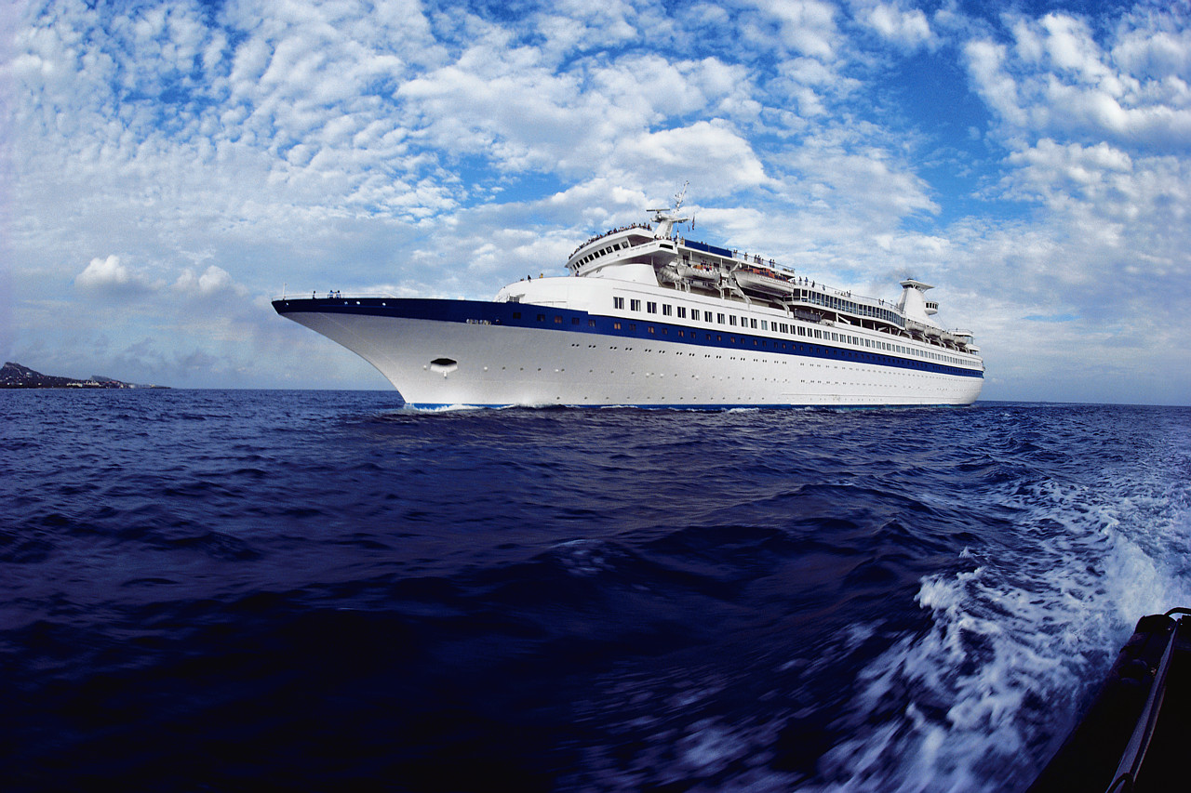

The Cruise Ship
The cruise ship has been here since the Steam Age and most of them are still with us such as the Queen Mary and some have not made it such as Titanic. Now the cruise age is for luxury such as the Oasis of the Seas.

Slide 6
Submarines
A submarine is practically a boat that dives. It is used for either warfare or for exploring. A Navy sub has torpedoes and guns. An exploratory submarine is normally used for deep diving and exploring.

Slide 7
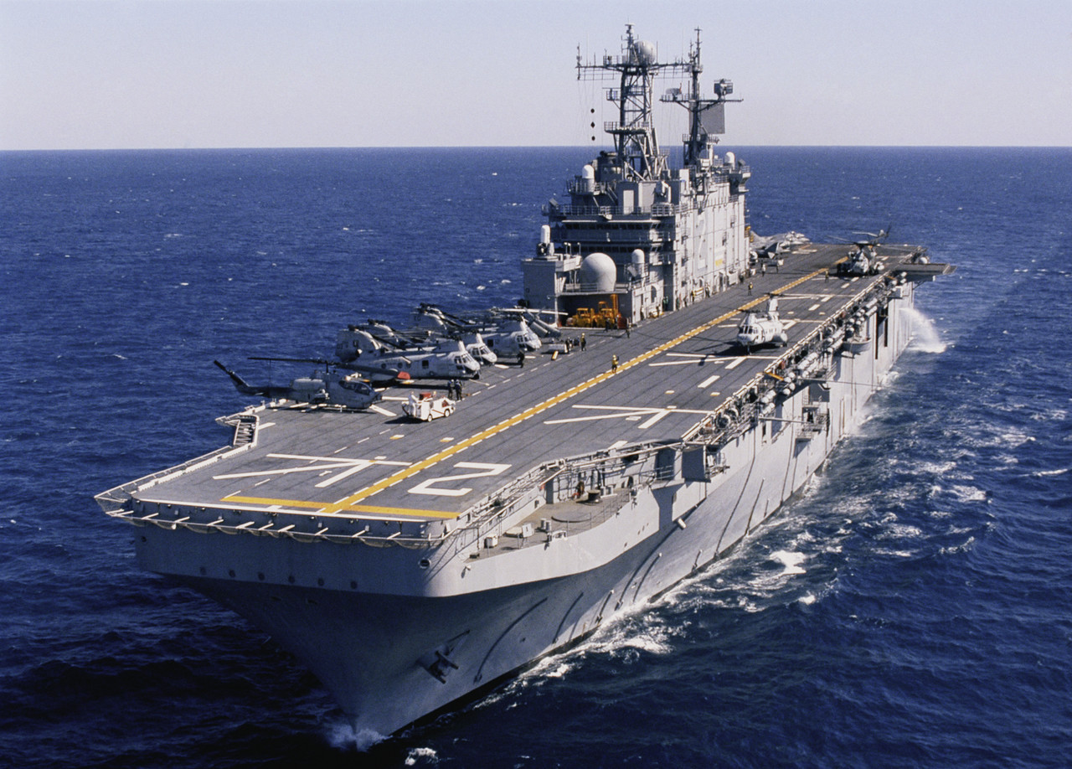
Aircraft Carriers
An aircraft carrier is a giant floating airfield. They are used mainly used by the Navy for fighter jets and helicopters. The carrier is essential for naval warfare.

Slide 8
All the Types of Ships

Slide 9
The End

